Slide 1
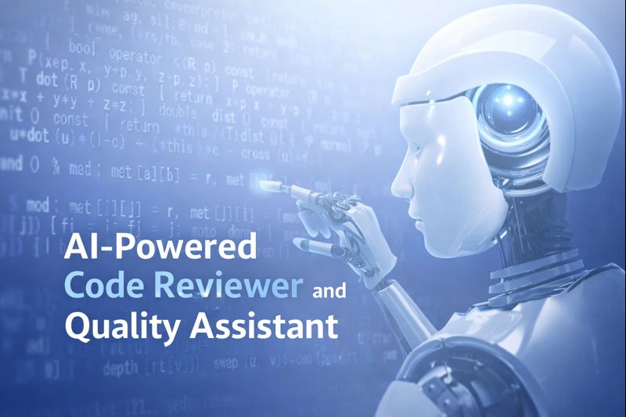

Slide 2
Problem Statement
Manual code reviews are slow, inconsistent, and difficult to scale for large Python codebases.
Existing tools lack contextual and intelligent feedback.
This project aims to build an AI-powered code reviewer that automates code analysis, docstring generation, validation, and workflow integration to improve code quality while reducing developer effort.

Slide 3

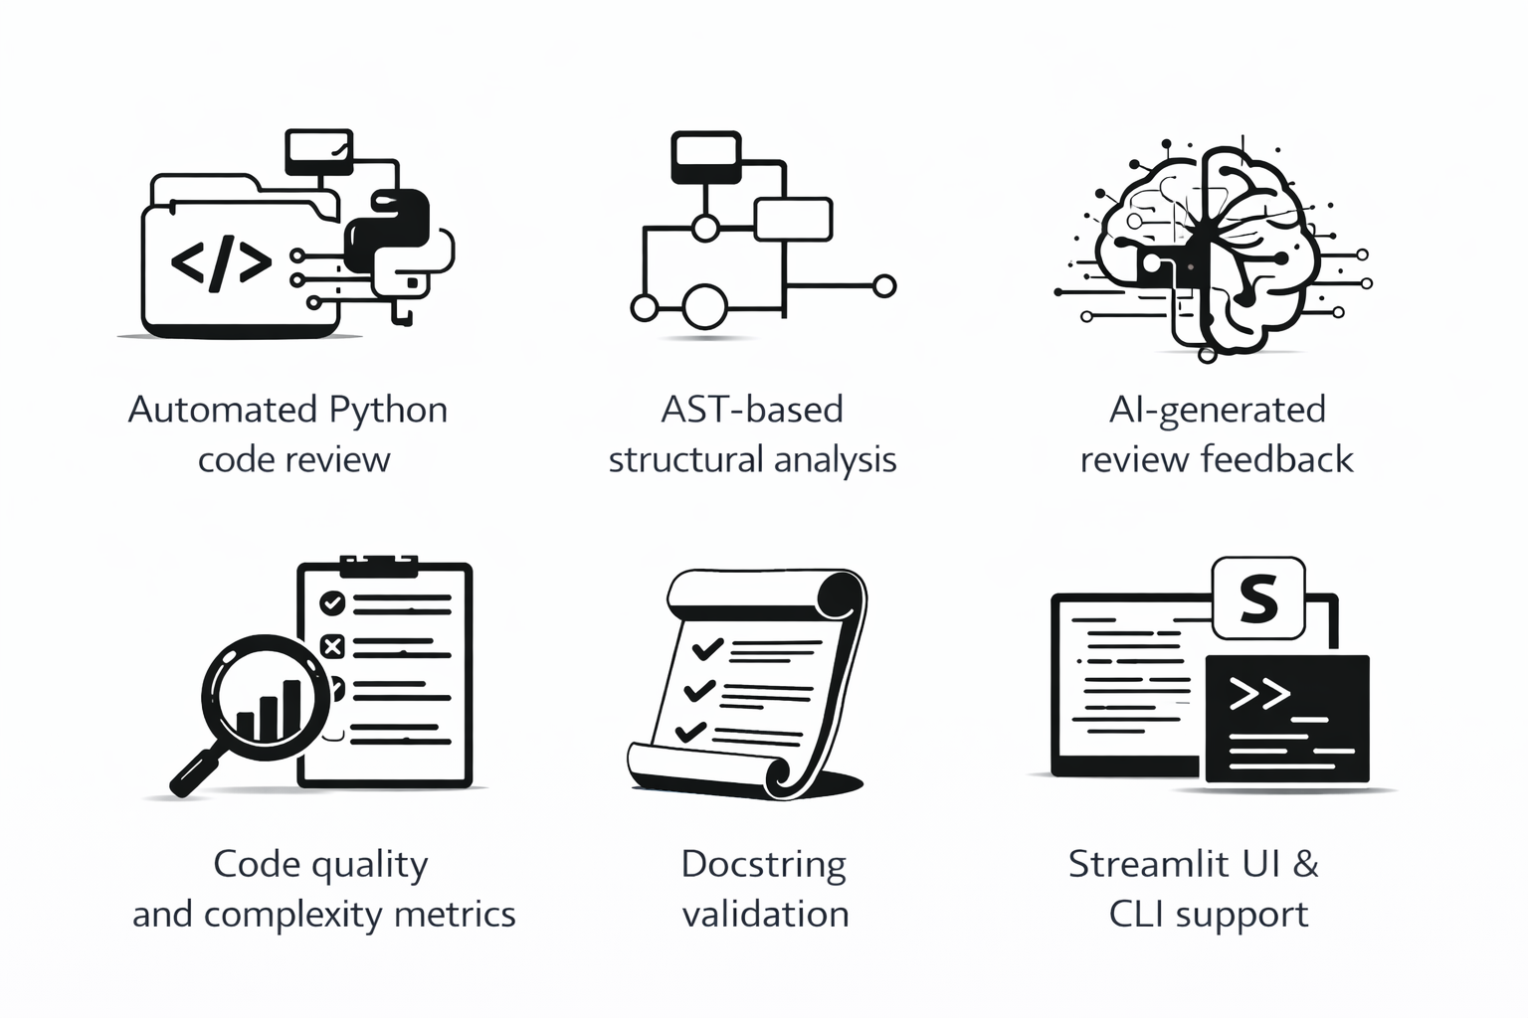
Proposed Solution
Design an AI-powered automated code review system to reduce manual review effort and improve consistency
Parse source code using an AST-based analyzer to understand code structure and logic accurately.
Apply an LLM-driven review engine to generate intelligent, human-like feedback and suggestions.
Evaluate code quality metrics such as complexity and documentation standards automatically.
Present results through an interactive Streamlit UI and CLI for easy review and usage.
Features

Slide 4
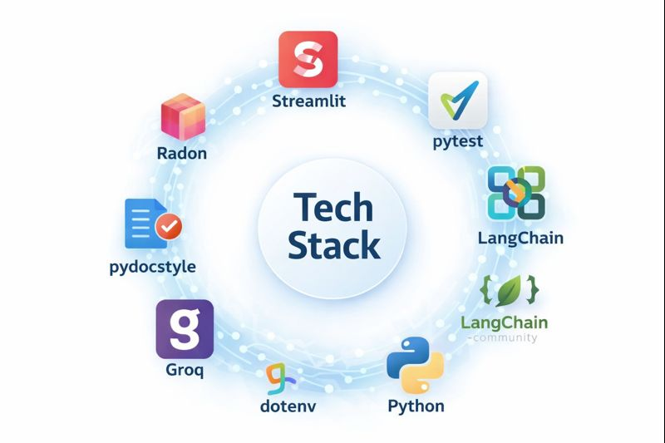
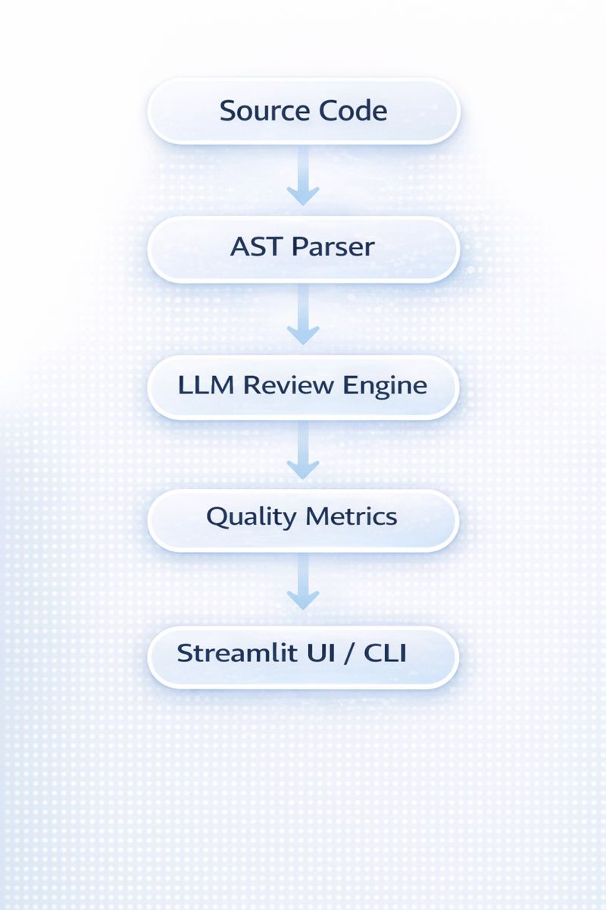
Web UI
System Architecture
Testing framework
Code complexity
LLM orchestration
Docstring Validation
LLM Integrations
Fast inference
Environment variables
Core language

Slide 5
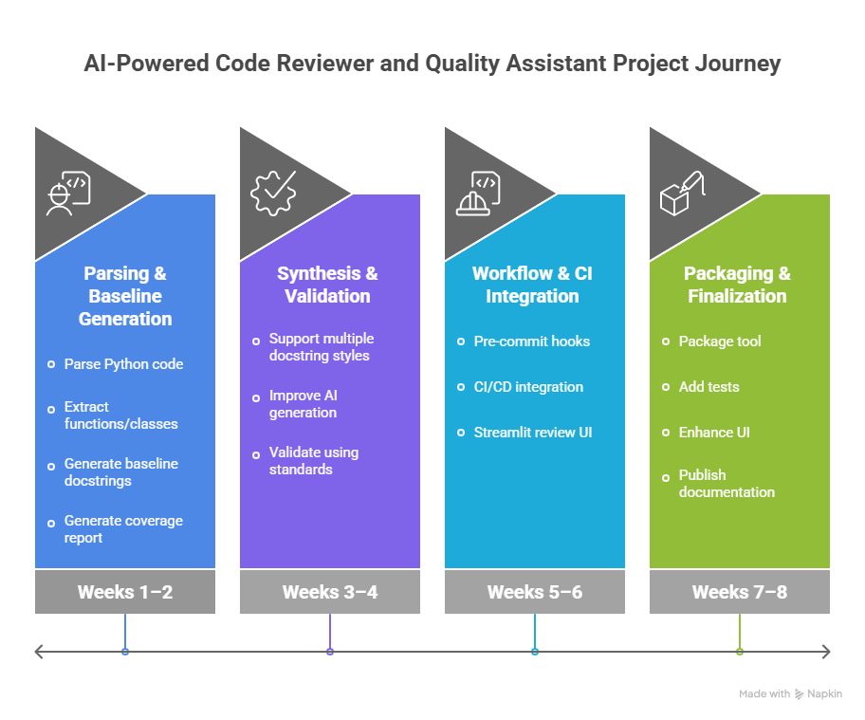

Slide 6
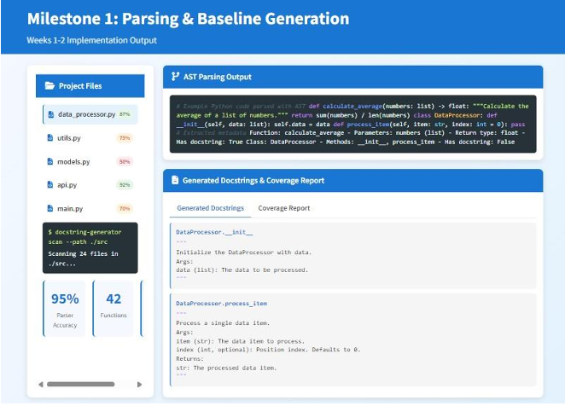
Milestone-1
Parsing and Baseline Generation
Implemented AST-based parsing to extract Python code structure (modules, classes, functions, imports).
Automatically generated baseline docstrings for missing documentation using standard formats.
Produced a docstring coverage report to measure documentation completeness.
Established a reliable foundation for further AI-based synthesis and validation stages.

Slide 7
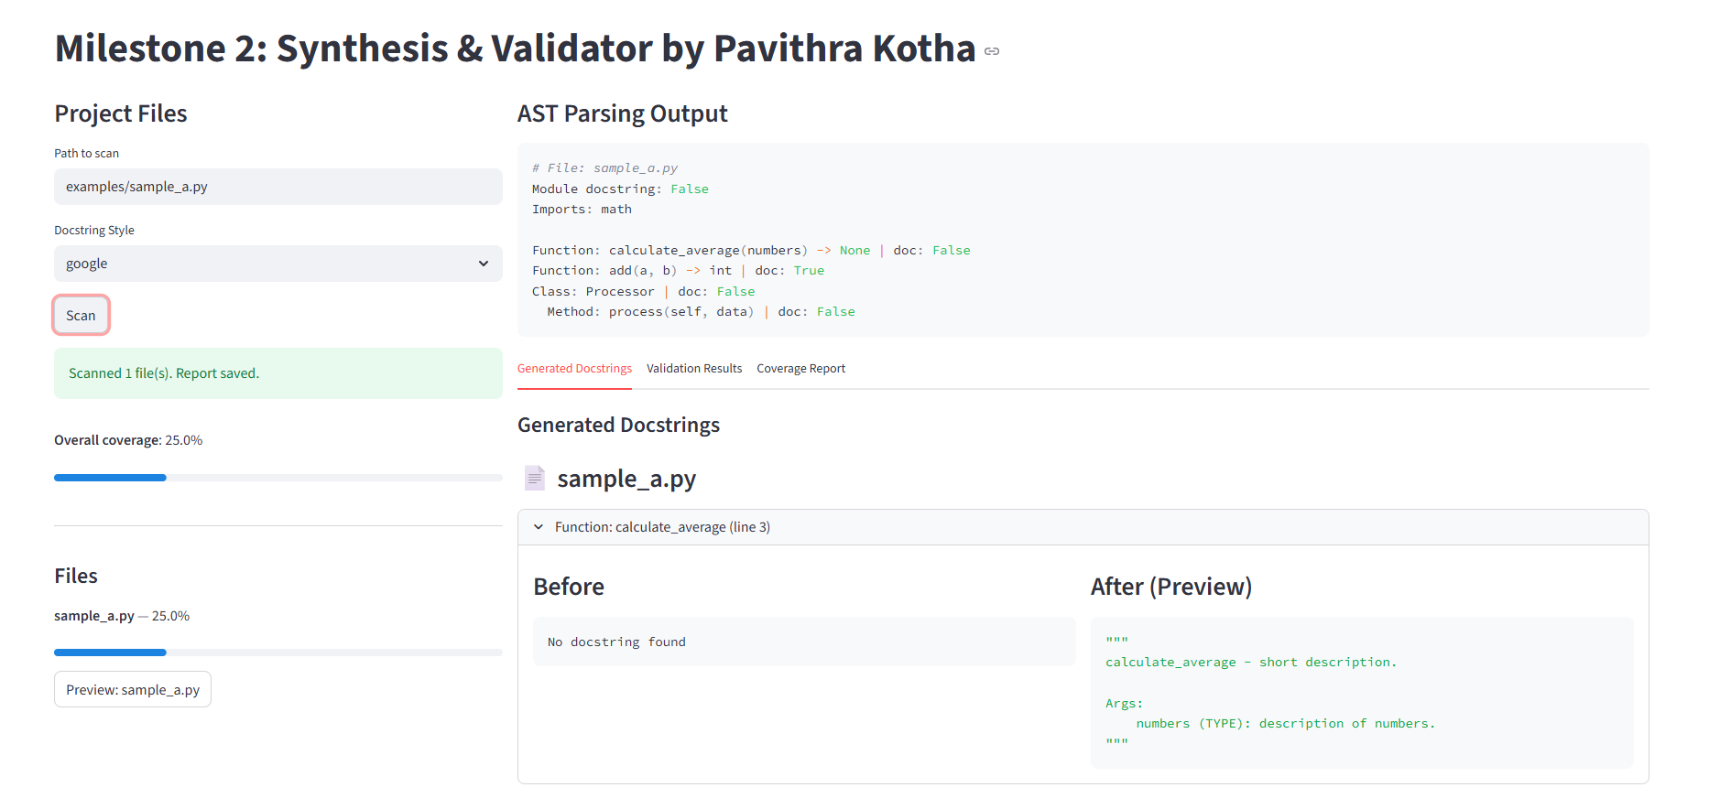
Milestone 2:
Synthesis & Validation

Slide 8
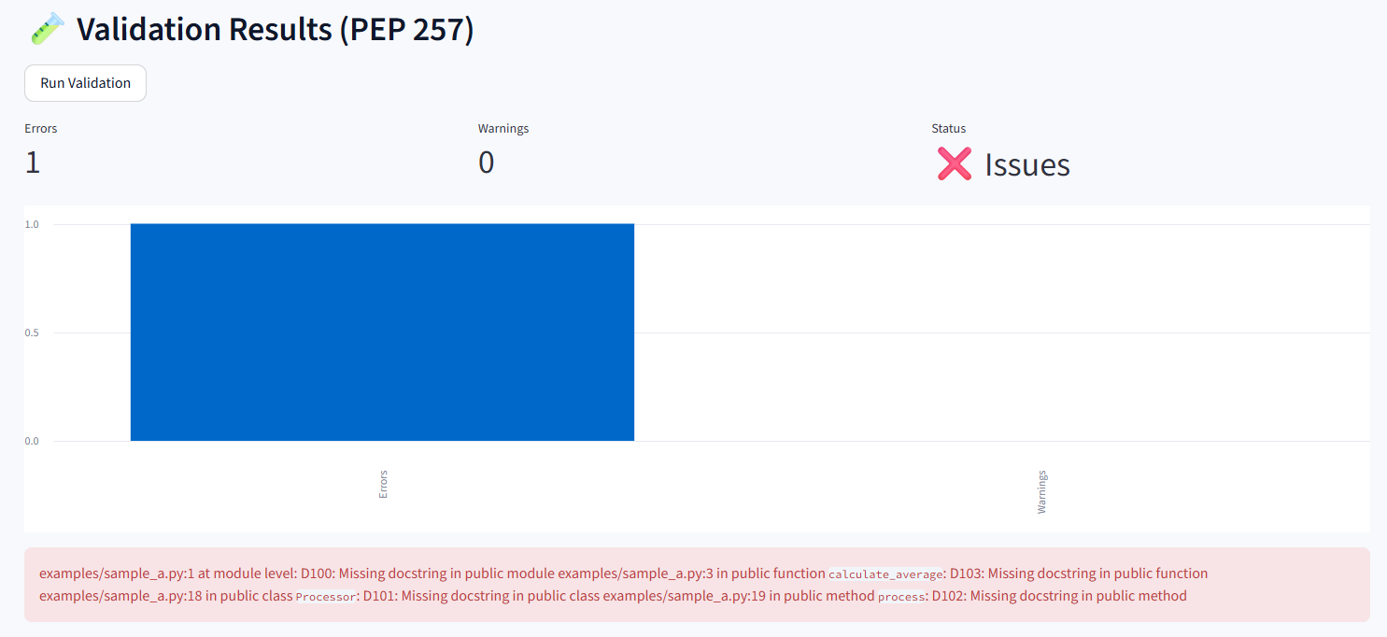
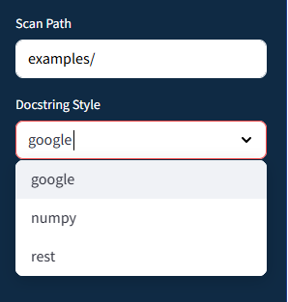
Extended docstring generation to support multiple documentation styles such as Google, NumPy, and reStructuredText.
Enhanced AI synthesis to include detailed sections like Parameters, Returns, Raises, and Attributes.
Integrated docstring validation checks to ensure compliance with documentation standards (PEP 257).
Generated improved coverage and validation reports highlighting warnings and errors.

Slide 9
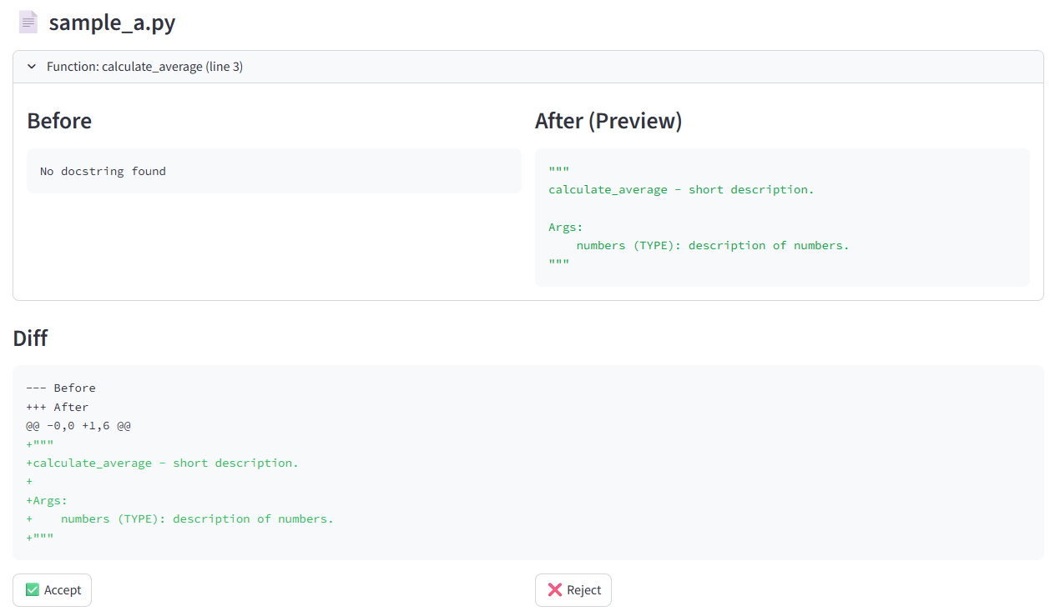
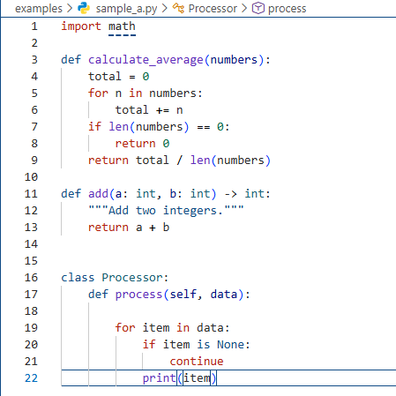
Milestone 3:
Workflow &CI
Google style
Before

Slide 10
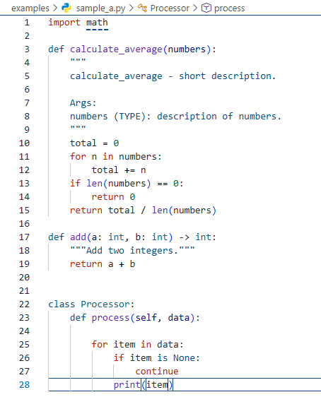
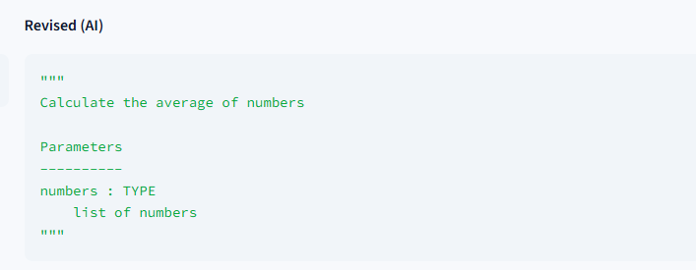
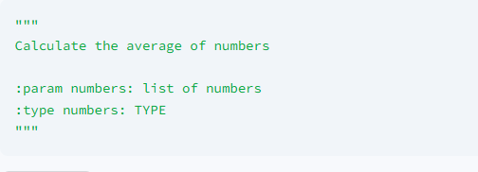
After
Implemented Git pre-commit hooks to automatically review staged files before commits.
Integrated CI workflows to enforce documentation coverage and quality thresholds.
Built a Streamlit-based review UI prototype for visualizing generated docstrings and suggestions.
Enabled configuration through pyproject.toml to control rules and coverage limits.
Numpy style
reST style

Slide 11
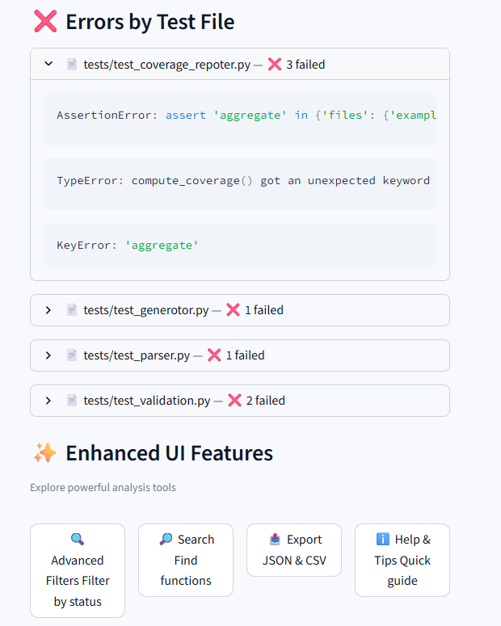
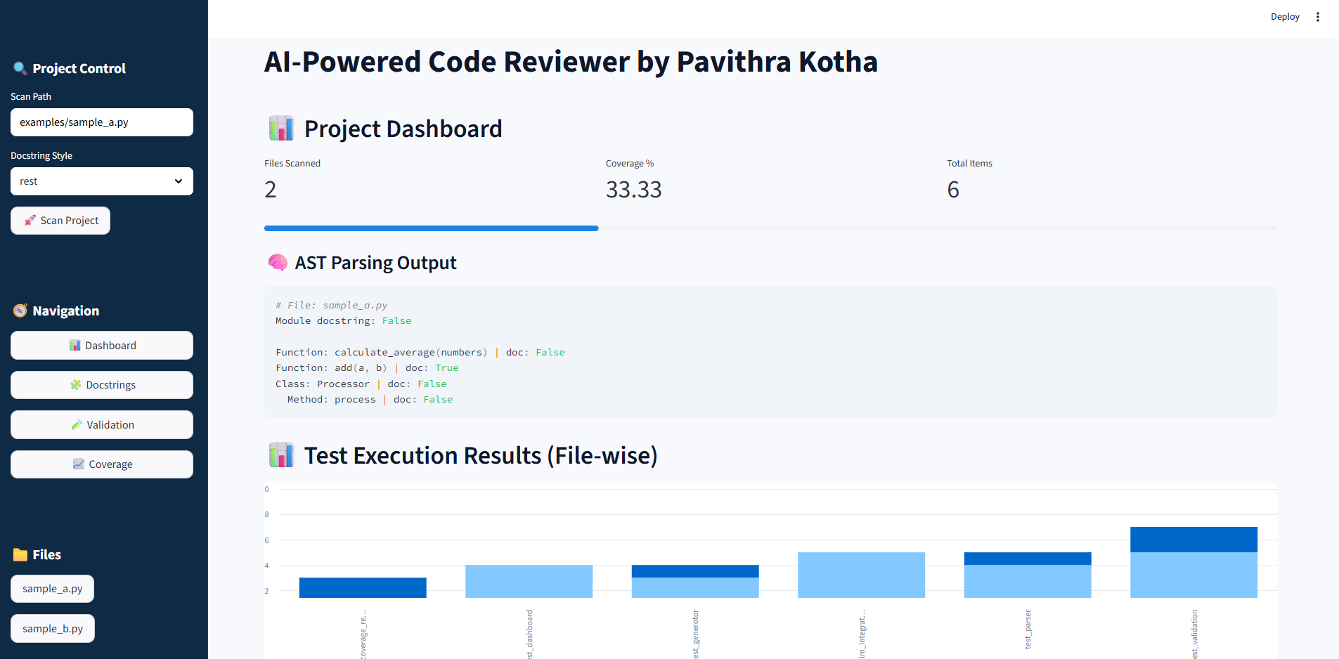
Milestone 4:
Packaging & Finalization
Added robust test cases to handel edge cases and ensure reliability
Enhanced the Streamlit UI with filters, Search, Export, tooltips

Slide 12
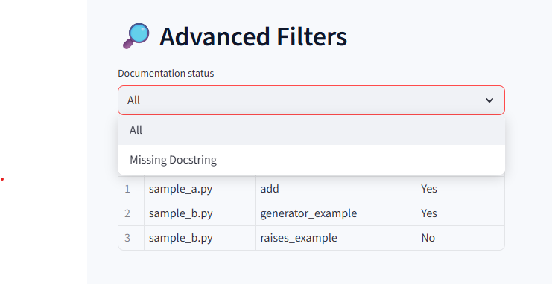
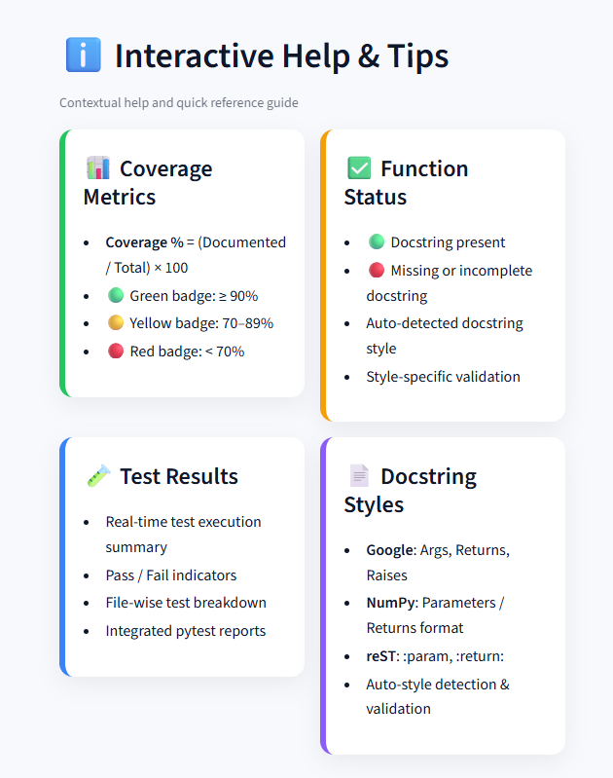
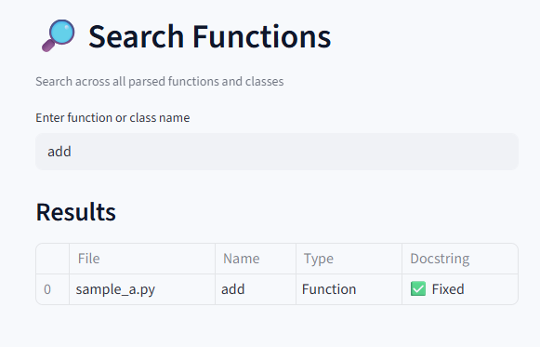

Slide 13
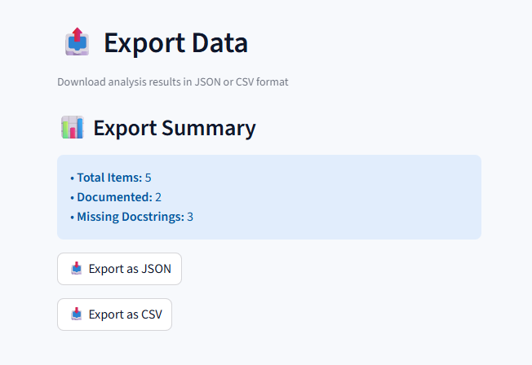
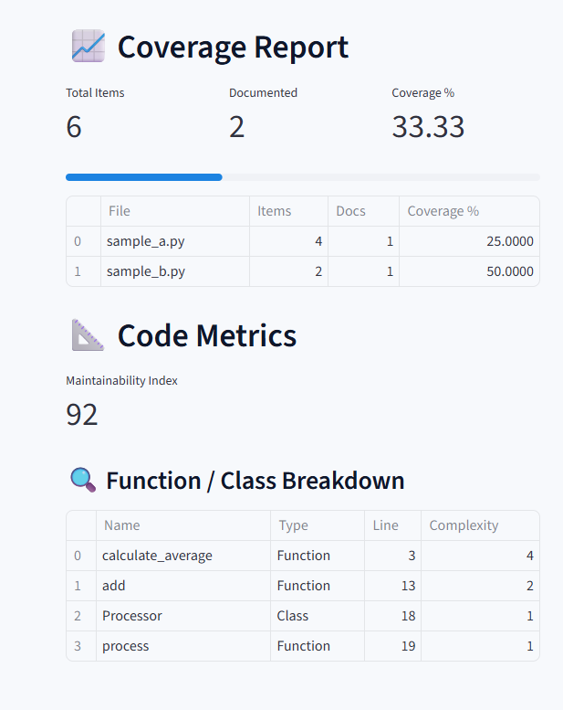
Packaged the project as a pip-installable Python library.
Published complete documentation and usage guides.

Slide 14


